Slide 1

OS LAB
Introduction

Slide 2
Benefits of attending the lab
Upon completion of this course, students should be able to:
Log on and off the system
Manage the password
Retrieve help information about Linux and UNIX commands
Use a variety of common commands
Access networked systems using standard applications
Recognize different types of files
Utilize a hierarchical file system with full and relative path names
Create and manage files and directories
Use the vi editor to create and modify file contents
Format and print information
Monitor and control program processes
Use simple shell features such as pipes and I/O redirection

Slide 3
Fundamentals Installation and Configuration
Getting Started
• Login/Logout
• Login-Logout Problems
• Start Terminal Session
Shell
• The UNIX Shell
• Commands
• Examples of Commands
• Command Execution Sequence
• Standard Input and Output
• Redirection (>,>>,<)
• Redirection (>,>>,<) Examples
• Pipelines: Connecting Command Processes
• Pipe Examples
• Paging Output
• Background Processing
• Shell Wild-card Matching
• Shell Wild-card Matching Examples

Slide 4
Shell Variables
• User Environment
• Working With Your Prompt
• Secondary Prompt
• hostname — Display System Name
• who — List Who Is Logged On
• tty — Display Terminal Device Name
• pwd — Print Working Directory
• ps — Process Status
• nice — Run a Command at Low Priority
• kill — Kill a Process
• kill Examples
• df — Report Number of Free Disk Blocks and i-nodes
• df/bdf Example
• du — Summarize Disk Usage

Slide 5
Why do we need an Operating System?
Write a program to sort n elements
Hardware (resource)
Disk
Input/ Output
CPU
Memory

Slide 6
What is an Operating System? (User’s view)
A program that acts as an intermediary between a user of a computer and the computer hardware
Defines an interface for the user to use services provided by the system
Creates an environment for the user

Slide 7
What is an Operating System? (User’s view)
Abstract Machine
Hides complex details of the underlying hardware
Provides common API to applications and services
Simplifies application writing
Command Interpreter
Part of a OS that understands and executes commands that are entered interactively by a human being or from a program
Shell

Slide 8

What is an Operating System? (User’s view)
Application
Shell
Operating System
CPU
Memory
Video Card
Network
Monitor
Disk
Printer

Slide 9
Why is abstraction important?
Without OSs and abstract interfaces, application writers must program all device access directly
load device command codes into device registers
understand physical characteristics of the devices
Applications suffer!
very complicated maintenance and upgrading
no portability

Slide 10

What Operating Systems Do (User’s view)
Depends on the point of view
Single user system
Users want convenience, ease of use
Don’t care about resource utilization
Optimized for single user experience

Slide 11
What is Unix?
The Unix operating system is a set of programs that act as a link between the computer and the user.
The computer programs that allocate the system resources and coordinate all the details of the computer's internals is called the operating system or the kernel.
Users communicate with the kernel through a program known as the shell.
The shell is a command line interpreter; it translates commands entered by the user and converts them into a language that is understood by the kernel.

Slide 12
The main concept that unites all the versions of Unix is the following four basics −
Kernel: The kernel is the heart of the operating system. It interacts with the hardware and most of the tasks like memory management, task scheduling and file management.
Shell: The shell is the utility that processes your requests. When you type in a command at your terminal, the shell interprets the command and calls the program that you want. The shell uses standard syntax for all commands. C Shell, Bourne Shell and Korn Shell are the most famous shells which are available with most of the Unix variants.
Commands and Utilities: There are various commands and utilities which you can make use of in your day to day activities. cp, mv, cat and grep, etc. are few examples of commands and utilities. There are over 250 standard commands plus numerous others provided through 3rd party software. All the commands come along with various options.
Files and Directories: All the data of Unix is organized into files. All files are then organized into directories. These directories are further organized into a tree-like structure called the filesystem.

Slide 13
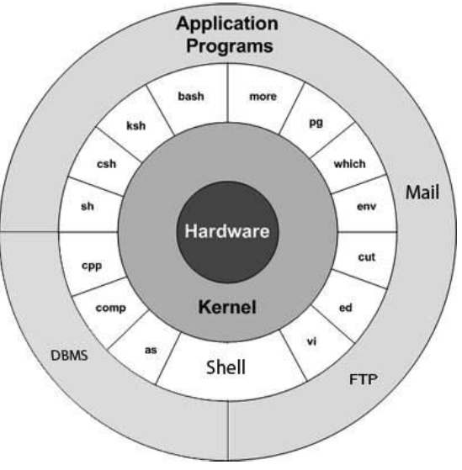

Slide 14
Lab Assignments:
List the names of the users logged in and their total count without displaying any further details.
Find out your terminal’s device name.
Display current date in the form dd/mm/yyyy.
Find out your machine’s name and the version of the operating system.
Clear the screen and place the cursor at row 12, column 25.
Find the decimal equivalent of 1101001.
Find out the users who are idling.
Use man to get help
Ensure that bc displays the results of all divisions using three decimal places.

Slide 15
Solutions:
1) a) $ who -q
b) $ tty
c) $ date +% d/%m/%Y
d) $ uname -nr
e) $ clear
$ tput cup 12 25
f) $ bc
ibase=2
g) $ who -Hu
h) $ man tty
I) $ bc
Scale=3

Slide 16
File Commands
Command Examples
• cat — Concatenate and Display
• echo — Output a String
• is — List Directory Contents
• mkdir — Make Directories
• cd and pwd
• cp — Copy files and directories
• rm — Remove Files or Directories
• In — make links between files
• Symbolic Links
my — Move or Rename Files
• rmdir — Remove Empty Directories
• tail — Output the Last Part of Files
• file — Determine File Type
• find — Find Files
• chmod — Change Mode
• chmod and Directories

Slide 17
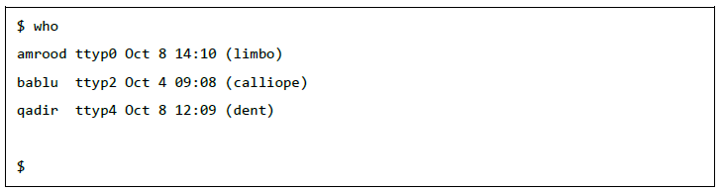
$ who -q
who command is used to find out the following information : 1. Time of last system boot 2. Current run level of the system 3. List of logged in users and more.
Description : The who command is used to get information about currently logged in user on to system.
Syntax : $who [options] [filename] Examples :
1. The who command displays the following information for each user currently logged in to the system if no option is provided :
Login name of the users
Terminal line numbers
Login time of the users in to system
Remote host name of the user
hduser@mahesh-Inspiron-3543:~$ who hduser tty7 2018-03-18 19:08 (:0)

Slide 18
passwd command in Linux is used to change the user account passwords. The root user reserves the privilege to change the password for any user on the system, while a normal user can only change the account password for his or her own account.
Syntax:
passwd [options] [username]
Example:
Command: passwd

Slide 19
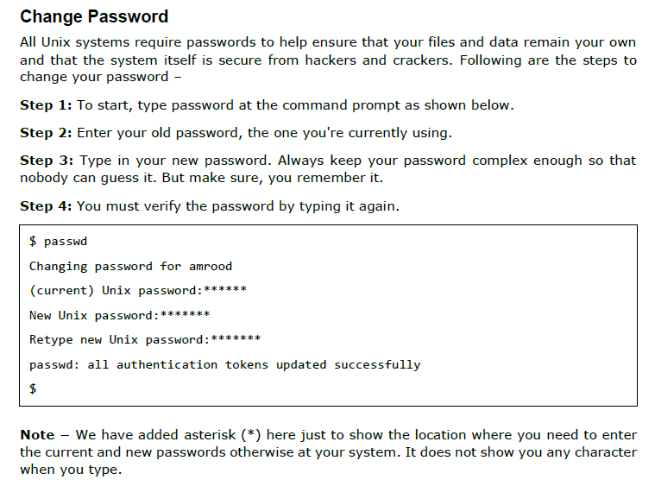

Slide 20
Command [root]: passwd user1
Note: sudo can be used to invoke root privileges by normal users, and can change the password for root itself. This is particularly helpful when a user is member of admin group (holds a position in sudoers list (/etc/sudoers) and can use commands with sudo) and the root password is not set, which is case with many common distributions of linux.
Command: sudo passwd root
Processing in passwd command:
Verify current user password : Once the user enters passwd command, it prompts for current user password, which is verified against the password stored in /etc/shadow file user. The root user can bypass this step and can directly change the password, so as the forgotten passwords may be recovered.
Verify password aging information : In Linux, a user password can be set to expire after a given period of time. Also, a user can be prohibited to change his/her password for a period. This password aging information (and the password itself) is stored in a file /etc/shadow.
Change the password : After authentication, the user is prompted to enter the new password and verify it by retyping the password.

Slide 21
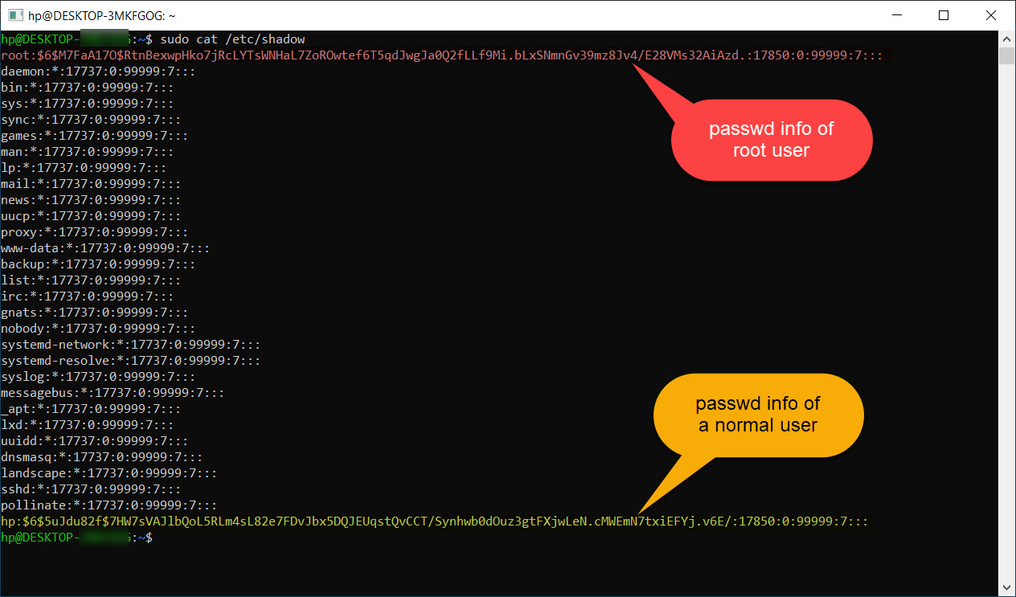

Slide 22
/etc/shadow file: The shadow file is a list of colon separated values with 9 fields, as shown below:
user1:$6$x8wAJRpP$EWC97sXW5tqac10Q2TQyXkR.1l1jdK4VLK1pkZKmA2mbA6UnSGyo94Pis074viWBA3sVbkCptSZzuP2K.y.an/:17887:0:99999:7:::
field 1: User name.
field 2: Encrypted Password.
field 3: Number of days since January 1, 1970 to when the password was last changed.
field 4: Minimum number of days for which password can not be changed. (value 0 means it can be changed anytime).
field 5: Number of days after password must be changed. (value 99999 means that the password never expires).
field 6: Number of days to warn user for expiring password.
field 7: Number of days after password expires that the account is disabled.
field 8: The number of days from January 1, 1970 to the date when an account was disabled.
field 9: This field is reserved for some possible future use.

Slide 23
-h, –help: Display help related to the passwd command.
-i, –inactive INACTIVE_DAYS: This option is followed by an integer, INACTIVE_DAYS, which is the number of days after the password expires that the account will be deactivated.
example: passwd -i 3 user1
-k, –keep-tokens: This option is used when you only want to change the password if it is expired. It keeps the authentication tokens for the authentication if the password is not yet expired, even if you requested to change it. Note that if the expiry period for a user is set to 99999, then this option will not keep tokens and the password will be changed.
-l, –lock: Lock the password of user. This appends the encrypted password of the user with a character ‘!’, and thus making it unable to match with any of input password combinations. This does not disable the account but prevents the user from logging in using a password. Though other authentication methods like ssh keys can be used to login to the account.
-n, –mindays MIN_DAYS: Change the minimum number of days between password changes to MIN_DAYS so that the user can’t change the password for MIN_DAYS.
-q, –quiet: This option is used for quiet mode. While using this option to change a password, the message “Changing password for $user.”, which usually gets printed before changing a password, does not get echoed.

Slide 24
-r, –repository REPO: This option is used to change password for repository named “REPO”.
-R, –root CHROOT_DIR: Apply changes in the CHROOT_DIR directory and use the configuration files from the CHROOT_DIR directory. This basically changes the root directory for the passwd process for once, and since CHROOT_DIR is a sub-directory of the root, it can not access the configuration files outside the CHROOT_DIR.
-S, –status: Shows the password status (7 fields) of user in the following format:
user1 P 12/22/2018 0 99999 7 3
The first field is the user’s login name. The second field indicates if the user account has a locked password (L), has no Password (NP), or has a usable password (P). The third field gives the date of the last password change. The next four fields are the minimum age, maximum age, warning period, and inactivity period for the password. These ages are expressed in days.
-S [, –status] -a [, –all]: This combination of options shows password status for all users. Note that -a or –all cannot be used without -S option.
-u, –unlock: Unlock the password of an account.
-w, –warndays WARN_DAYS: This option is used to change the number of days before the password is to expire, to display the warning for expiring password.

Slide 25
tty command :
Linux operating system represents everything in a file system, the hardware devices that we attach are also represented as a file. The terminal is also represented as a file. There a command exists called tty which displays information related to terminal.
The tty command of terminal basically prints the file name of the terminal connected to standard input. tty is short of teletype, but popularly known as a terminal it allows you to interact with the system by passing on the data (you input) to the system, and displaying the output produced by the system.

Slide 26
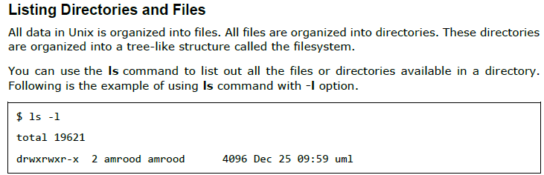

Slide 27
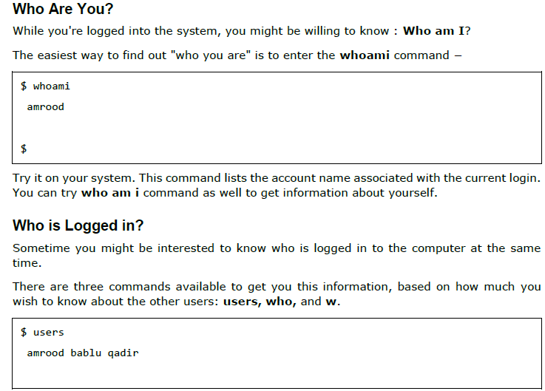

Slide 28
Display current date in the form dd/mm/yyyy.
$ date +% d/%m/%Y
Find out your machine’s name and the version of the operating system.
$ uname -nr
Clear the screen and place the cursor at row 12, column 25.
$ clear
$ tput cup 12 25

Slide 29
bc command:
bc command is used for command line calculator. It is similar to basic calculator by using which we can do basic mathematical calculations.
Arithmetic operations are the most basic in any kind of programming language. Linux or Unix operating system provides the bc command and expr command for doing arithmetic calculations. You can use these commands in bash or shell script also for evaluating arithmetic expressions.
Syntax:
bc [ -hlwsqv ] [long-options] [ file ... ]
Options:
-h, {- -help } : Print the usage and exit
-i, {- -interactive } : Force interactive mode
-l, {- -mathlib } : Define the standard math library
-w, {- -warn } : Give warnings for extensions to POSIX bc
-s, {- -standard } : Process exactly the POSIX bc language
-q, {- -quiet } : Do not print the normal GNU bc welcome
-v, {- -version } : Print the version number and copyright and quit

Slide 30
The bc command supports the following features:
Arithmetic operators
Increment or Decrement operators
Assignment operators
Comparison or Relational operators
Logical or Boolean operators
Math functions
Conditional statements
Iterative statements
1. Arithmetic Operators
Examples:
Input : $ echo "12+5" | bc
Output : 17
Input : $ echo "10^2" | bc
Output : 100

Slide 31
Perform multiple arithmetic operations:
$ bc [Enter]
2+2; 4+4 ; 9/5
4
8
1
If we want to get the answer up to two scale (9/5 = 1.80)
Scale =2
9/5
1.80

Slide 32
Piping in Unix or Linux
A pipe is a form of redirection (transfer of standard output to some other destination) that is used in Linux and other Unix-like operating systems to send the output of one command/program/process to another command/program/process for further processing.
The Unix/Linux systems allow stdout of a command to be connected to stdin of another command. You can make it do so by using the pipe character ‘|’.
Pipe is used to combine two or more commands, and in this, the output of one command acts as input to another command, and this command’s output may act as input to the next command and so on.
Pipes are unidirectional i.e data flows from left to right through the pipeline.
Example : 1. Listing all files and directories and give it as input to more command.
$ ls -l | more
Use cat, grep, tee and wc command to read the particular entry from user and store in a file and print line count.
$ ls -l | wc –l
$ cat sample2.txt | head -7 | tail -5

Slide 33
Cat command in Linux with examples
Cat(concatenate) command is very frequently used in Linux. It reads data from the file and gives their content as output. It helps us to create, view, concatenate files. So let us see some frequently used cat commands.
1) To view a single file
Command:
$cat filename
Output
It will show content of given filename
2) To view multiple files Command:
$cat file1 file2Output
This will show the content of file1 and file2
.3) To view contents of a file preceding with line numbers. Command:
$cat -n filenameOutput

Slide 34
sh and bash
bash and sh are two different shells of the Unix operating system. bash is sh, but with more features and better syntax. Bash is “Bourne Again SHell”, and is an improvement of the sh (original Bourne shell).
Shell scripting is scripting in any shell, whereas Bash scripting is scripting specifically for Bash. sh is a shell command-line interpreter of Unix/Unix-like operating systems. sh provides some built-in commands. bash is a superset of sh.
Shell is a command-line interface to run commands ad shell scripts. Shells come in a variety of flavors, much as operating systems come in a variety of flavors. So, Shell is an interface between the user and the operating system, which helps the user to interact with the device.
sh:
#!/bin/sh
bash:
#!/bin/bash

Slide 35
3) To view contents of a file preceding with line numbers.
Command:
$cat -n filename
Output
It will show content with line number
example:-cat-n geeks.txt
1)This is geeks
2)A unique array
4) Create a file
Command:
$ cat > newfile
Output
Will create a file named newfile

